Slide 1
Logistic Regression Analysis Voting Likelihood
By: Student Name

Slide 2
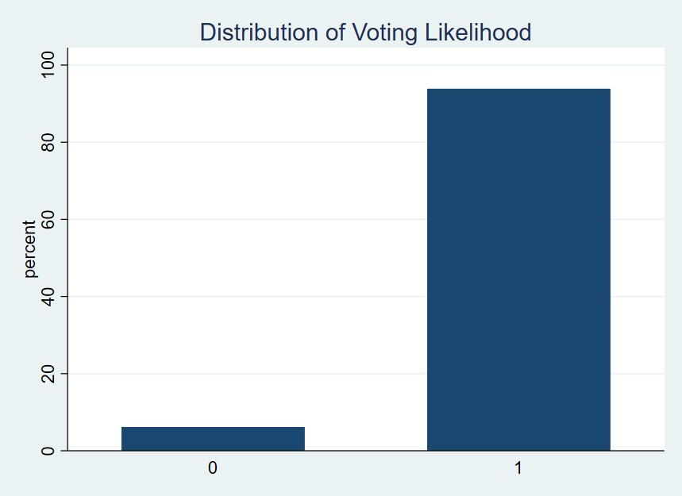
1.1 Correctly specify the dependent and major independent variables.
Dependent variable
vote_binary is the dependent variable since it has a binary variable indicating voting probability (1 = likely to vote, 0 = not likely to vote).
Major independent variables
cps21_genderid: Gender that relates to demographic and social factors influencing people’s voting habits.
cps21_education: education level, it also means the extent of which socioeconomic factors influence the voter turnout.
cps21_turnout_2019: Voter turnout in the 2019 federal elections is evidence of future voting behavior.

Slide 3
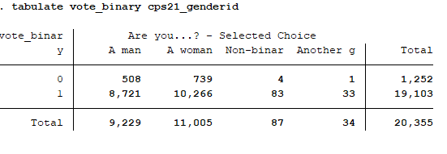
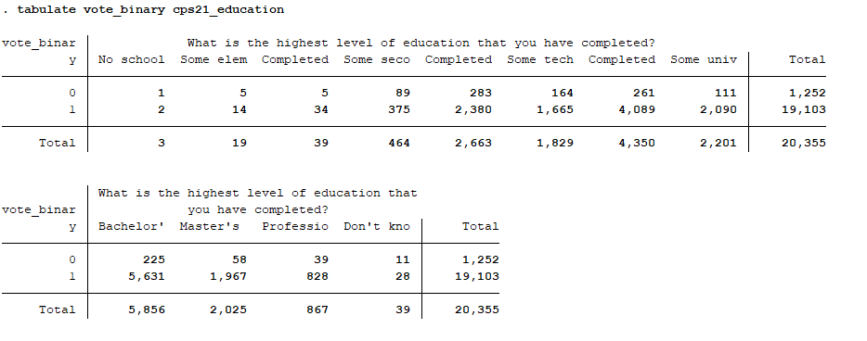
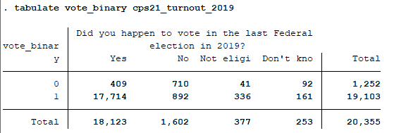
1.1 a) Most important independent variables
1
1
cps21_genderid: Gender determines the extent of political participation and rules for choosing a side among the citizens.
cps21_education Education is related to the process of being informed on public matters and involvement in the same.
cps21_turnout_2019: Turnout vote, meanwhile, is the strongest behavioral indicator of the likelihood to vote in the future.
.
1
2
2
3
3
2
3

Slide 4
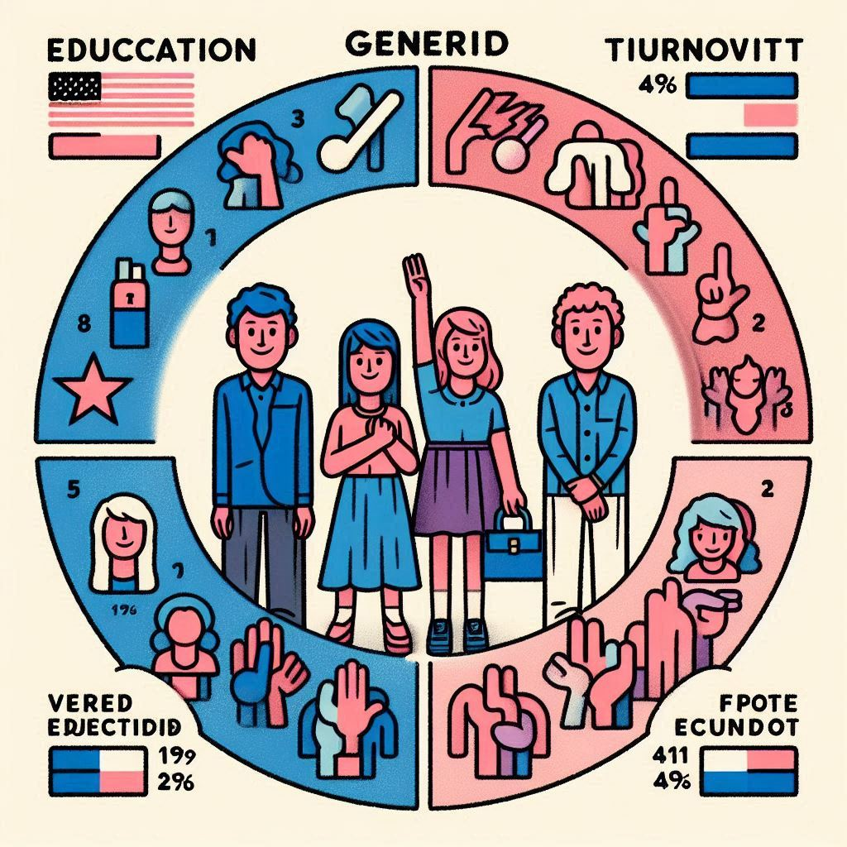
1.2 Hypotheses
1
cps21_genderid: It is hypothesized that women are more likely to participate in voting than men.
Expected sign: Positive
cps21_education: It is hypothesized that Voting also tends to increase with rising levels of education.
Expected sign: Positive.
cps21_turnout_2019: It is hypothesized that Past voters are likely to vote Again.
Expected sign: Positive strongly; high degree.
2
3

Slide 5
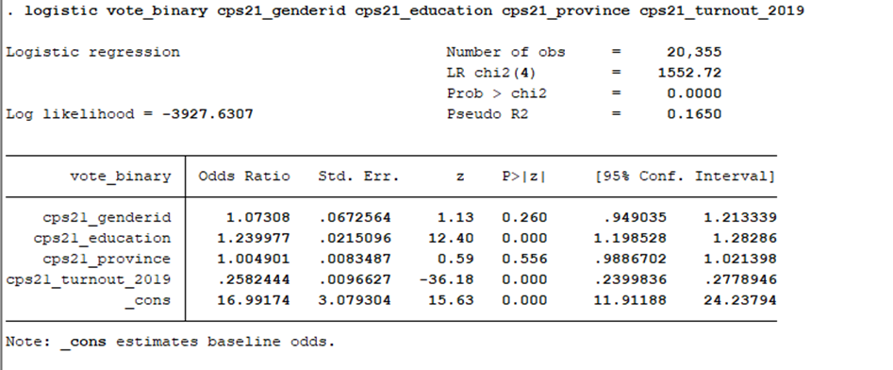
1.3 Run a logistic regression analysis and report Stata output.
Regression Equation:
logit(Y)=2.833+0.070(cps21_genderid)+0.215(cps21_education)+0.0049(cps21_province)−1.353(cps21_turnout_2019)+e
Where:
Y = vote_binary, the dependent variable.
2.833: The intercept.
0.070: Coefficient for cps21_genderid, indicating its impact on Y.
0.215: Coefficient for cps21_education, indicating a positive influence on Y.
0.0049: Coefficient for cps21_province, showing a minimal influence on Y.
-1.353: Coefficient for cps21_turnout_2019, indicating a significant negative influence on Y.

Slide 6
1.4 Interpret the coefficients and model statistics.
1
The gender variable (cps21_genderid): odds ratio = 1.073, < p 0.05. There is no influence of gender where the probability of voting is concerned.
Education (cps21_education): Odds ratio = 1.24, p < 0.01. The results show that raising the level of education by one unit raises the probability of a likely voter by 24%.
The province (cps21_province): Odds ratio =1.00, < p 0.05. The results illustrate province of residence does not affect the probability of voting.
The Past Turnout (cps21_turnout_2019): = Odds ratio = 0.26, < p 0.01. 69% of 2019 non-voters will not vote again because they have no interest in the process.
Model Fit:
The LR chi-square value of 1552.72, < p 0.01. Shows that the model is correct.
Pseudo R²: 0.165, meaning the given model accounts for 16.5% of the voting propensity variability.
2
1
3
4

Slide 7
1.5 If you have access to any data you want, what other variables will you include in your regression equation? Why?
If additional data was available, the following variables would enhance the model:
Political Interest: quantifies an individual's political activity, which can be used to determine the voting intent.
Income Level: SES determines one’s level of volunteering and his or her likelihood of voting.
Media Consumption: The number of news sources watched can serve as an indicator of an individual's exposure to political information.
Party Affiliation: Shows the intensity of political party identification, which is highly related to the propensity to vote.
1
2
1
3
4

Slide 8
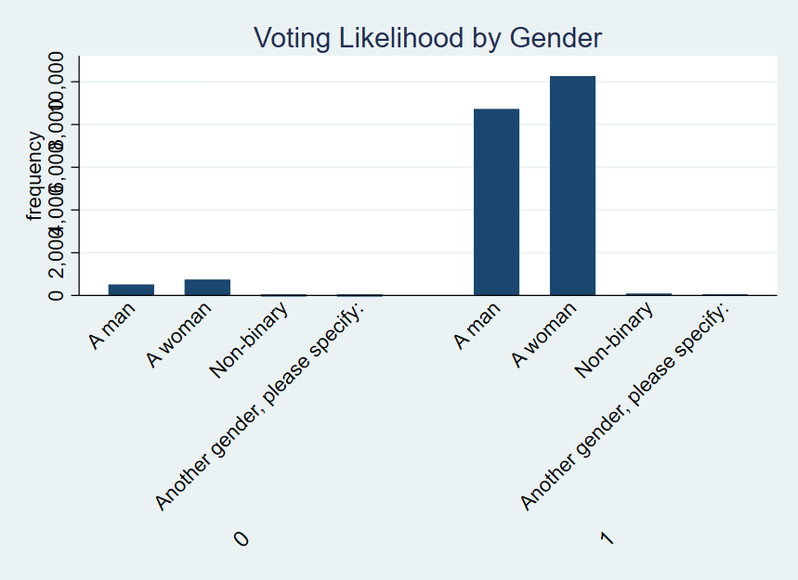
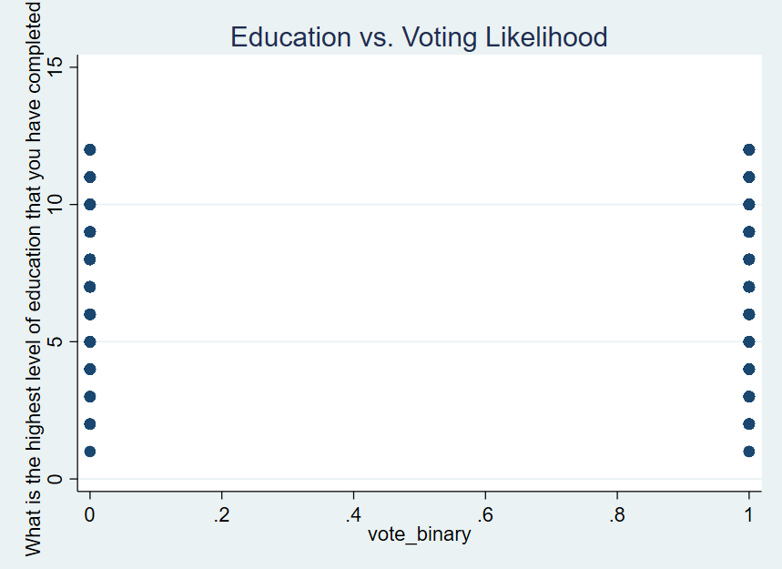
Graph

